Slide 1
IML End-Term Assignment
Prepared By:
Darshan Jain (D21011)
Lohith Boddu (D21021)

Slide 2
Table of content
Objective
Hypothesis
EDA
Initial model fitting - Linear Regression
Feature engineering
Model fitting – Forward selection/Backward selection
Model fitting – Decision Tree
Model Testing

Slide 3
Objective
The main objective of this assignment is to create a house price prediction model for the dataset which we have been provided.
Dataset contain information regarding the house sold in the houses sold in King County, Washington State, USA, in the period between May 2014 – May 2015.
The training data contains the 21 features (such as no of pricebedroom, bathroom, square foot living etc.) and 9761 observations.
Of the all the 21 features we will consider our price as our target feature

Slide 4
Hypothesis
After giving the first look at the data we have assigned price as our target variable.
For choosing predictors, we will first try make an assumption/hypothesis about the the effect of the change in the rest of the 20 features on the target variable.
To test the assumption/hypothesis, we have later done some exploratory data analysis to find the out the accuracy of the assumption.
The assumption and their validation statement can be seen side by side, with later in the bold text.

Slide 5
Exploratory Data Analysis

Slide 6
Exploratory Data Analysis
At first we checked the nature of the features and its type
Then we tried to find out the if there any missing values in the data or not?
There were no missing values in the data
We dropped the id and date sold column in the EDA process, as we concluded it won’t have much effect on the price
The date column have been later used to find out the age of the house.
Then we started finding out some relationship between each individual features and the price

Slide 7
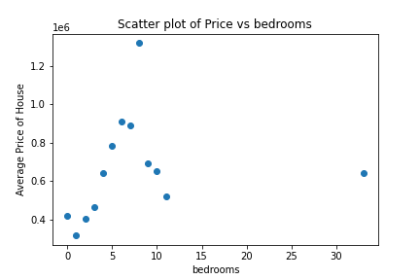
Bedroom & Price
By selecting the bedroom and price feature and grouping them the number of bedrooms, we see that as bedrooms size increases from 1 to 6 we see the average prices of houses sold increases.
The conclusion cannot be made for the rest of the data as the not enough data is available.

Slide 8
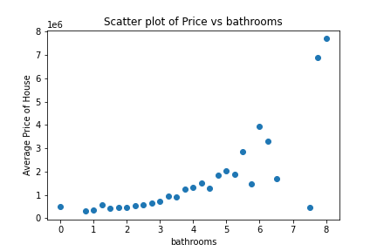
Bathrooms & Price
We have observed as that as the number of bathrooms in home increases the average prices of the house but until the count of 5-6 bathrooms.
After the 5-6 bathrooms, the increase in bathrooms does not have any effect on the prices of the house

Slide 9
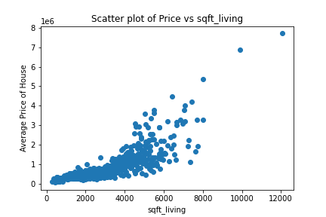
Square foot living & Price
We have hypothesized that the increase in square foot should in increase in the prices of the house.
The hypothesis have been proven correct and we can see this relationship the following charts and we decided to consider this feature as one of our primary predictors

Slide 10
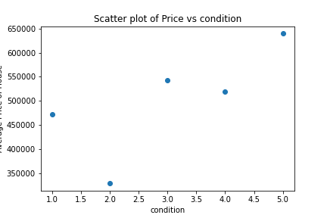
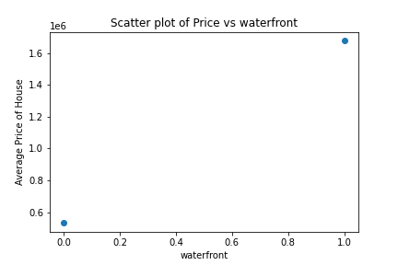
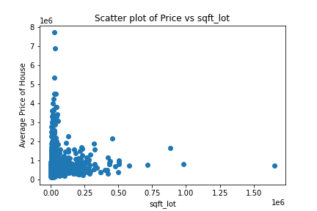
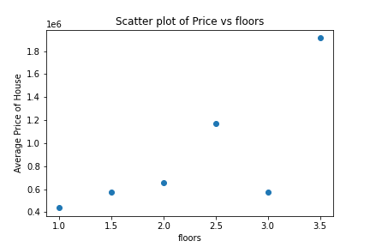
Here apart from floors and we do not see much correlation between prices and other features

Slide 11
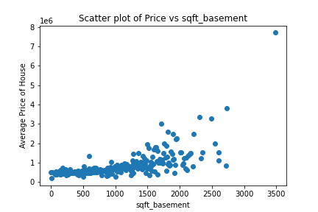
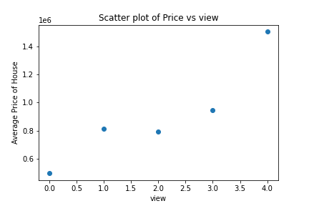
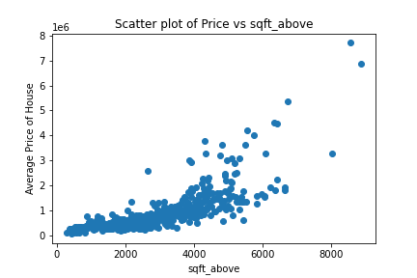
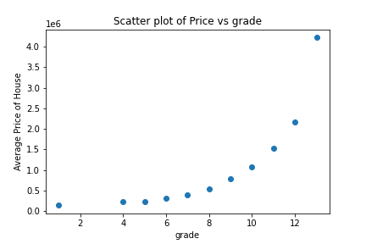
Positive correlation between Price and sqft_basement
We can see the increase in sqft_above and grade, increases the Price of the house.
We can see some weak positive correalation between the view and price of the house

Slide 12
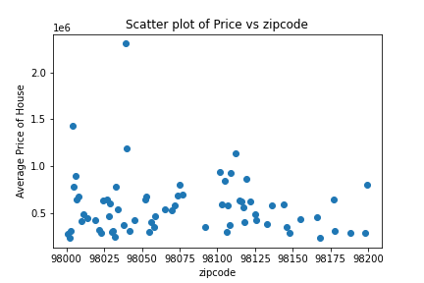
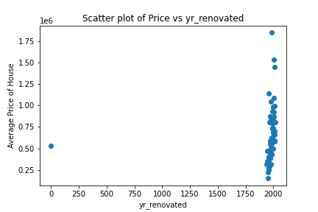
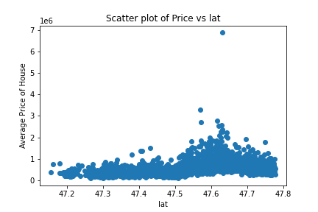
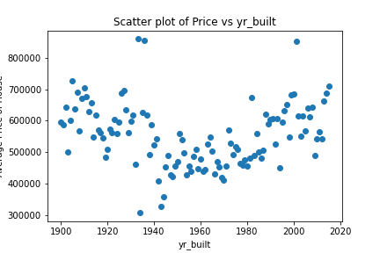
We can see that there is no relationships between the given features and prices

Slide 13
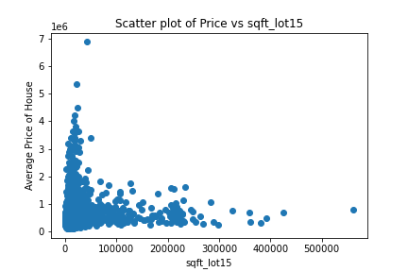
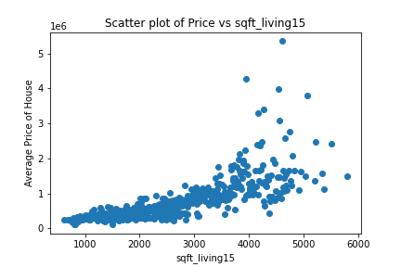
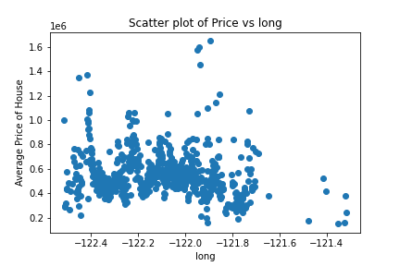
Here we can observe there is no solid relation between longitude and sqft_lot_15.
But we can see some strong positive correlation between price and sqft_living_15
i.e. as the sqft_living_15 increases the price of the hosue also increases

Slide 14
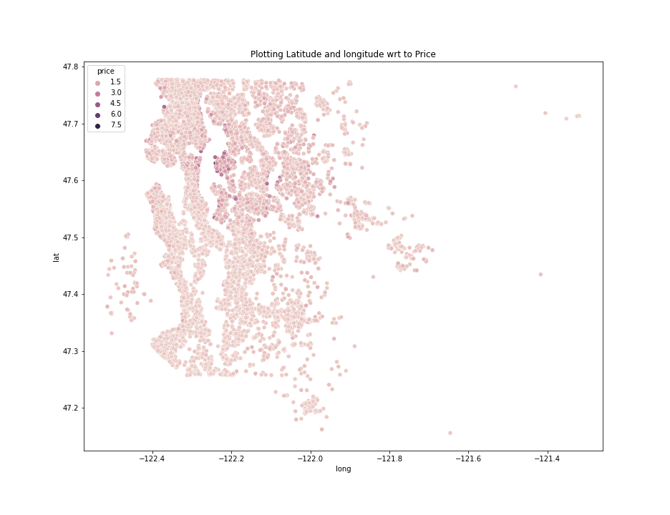
So here we can clearly see the darker points at higher altitudes in the above scatter plot. Verified the mean price above and below latitude mean. So this is impacting the price. So considered latitude and longitude.

Slide 15
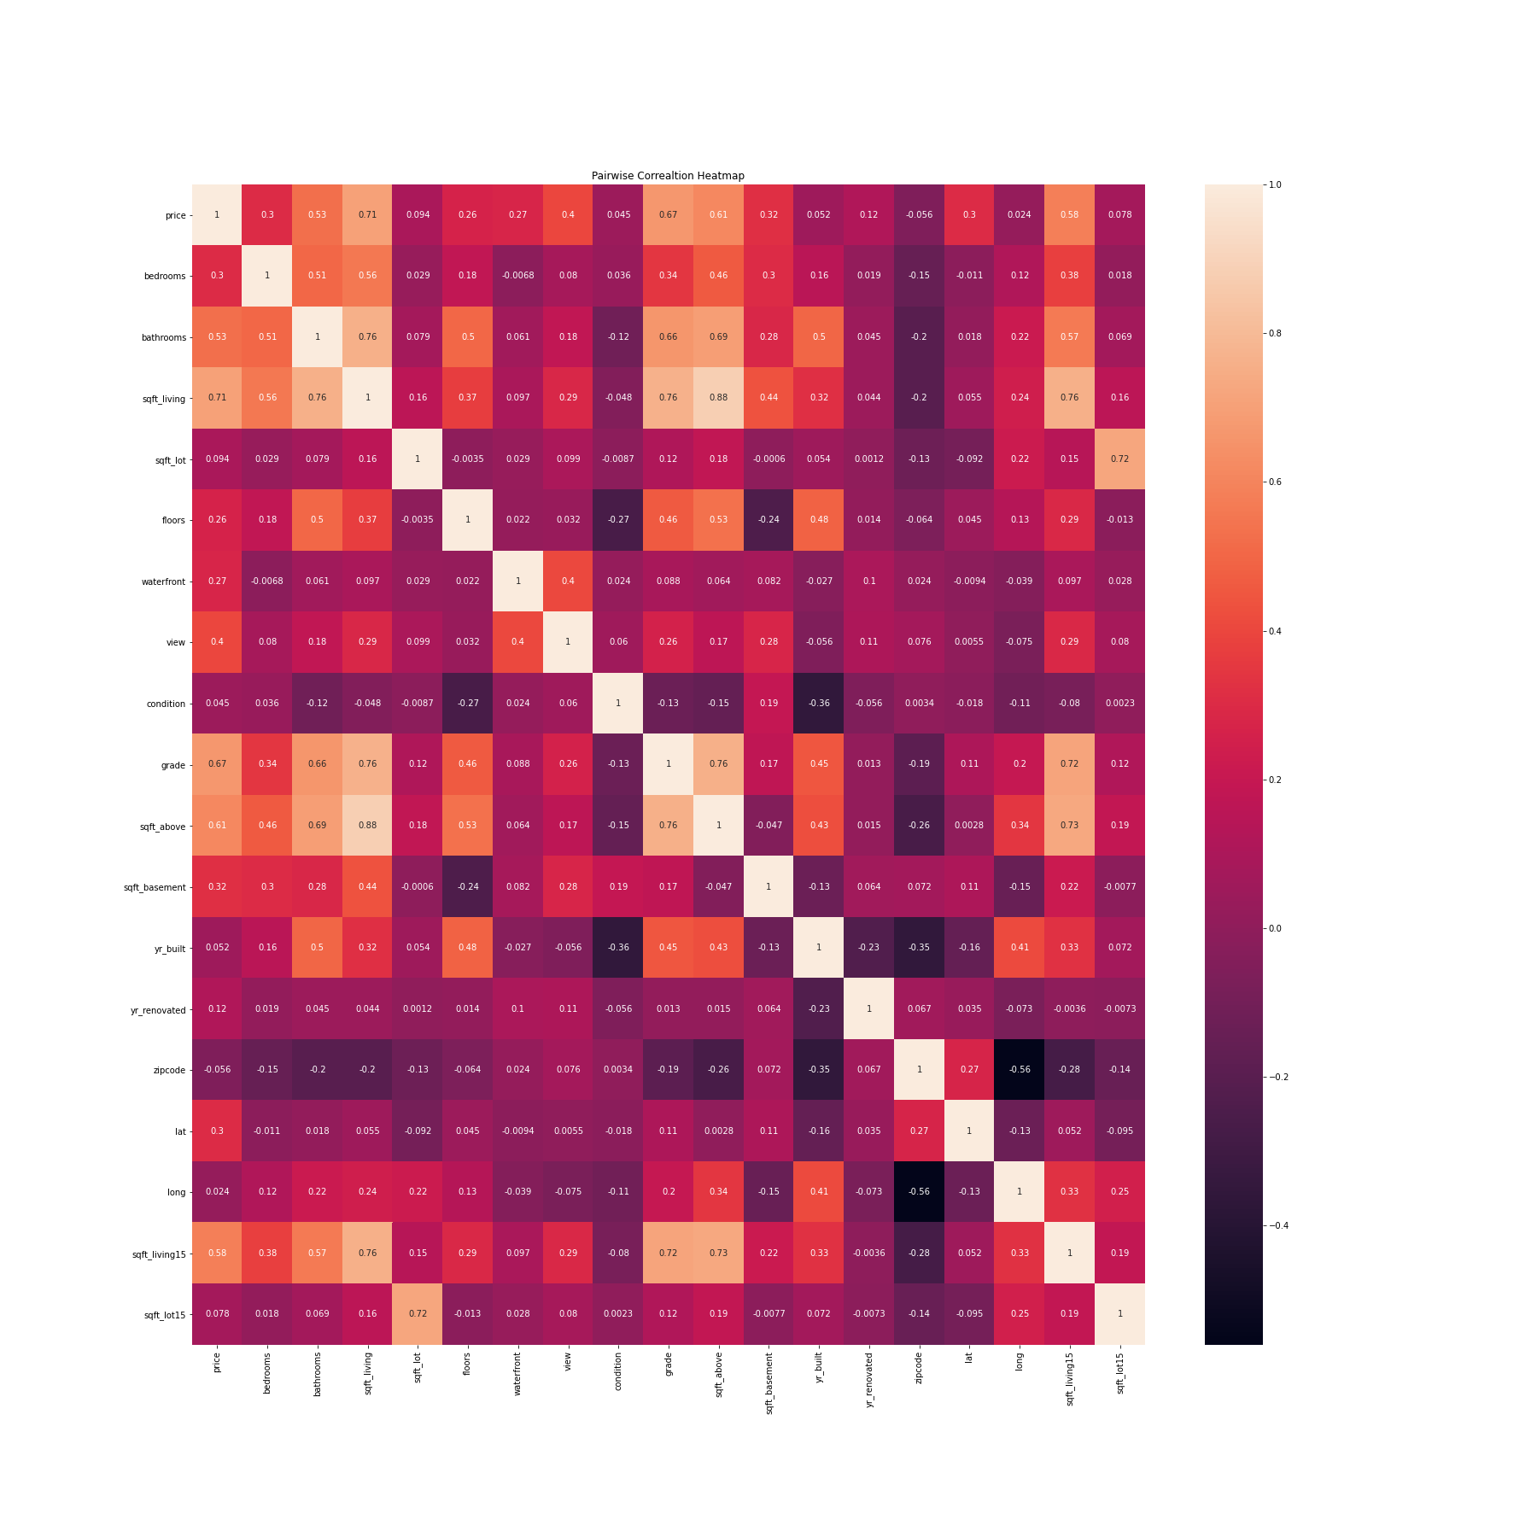
Here we have created a pairwise correlation between all the variables
Here we can see that the price has very high correlation with sqft_living15, sqft_above, grade, sqft_living, bathrooms
Also price has mild correlation with view, bedrooms, sqft_basement, waterfront, condition and floors
Also, we also spot multicollinearity between sqft_living and sqft_living_15 and sqft_living and sqft above.
This helped us the select the predictors carefully.

Slide 16
Initial Model fitting
Linear Regression

Slide 17
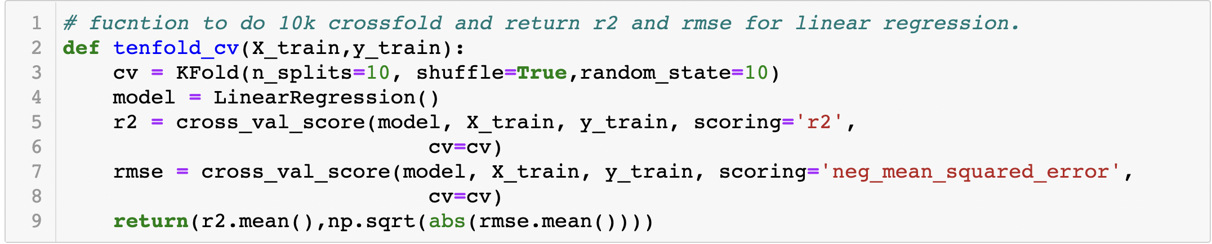
Model Fitting – Linear Regression
After the EDA analysis, we have sort-listed few of the features which we can use as the predictors in the linear regression process.
Later we have some sets of predictors and checked the accuracy of the model and among them we have selected the model with the highest R square and lower RMSE score.
Moreover, we have created a 10-k crossfold function which will take in the X_train, and y_train data and will return R Square and RMSE score

Slide 18
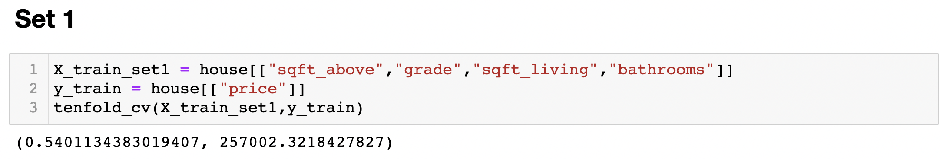
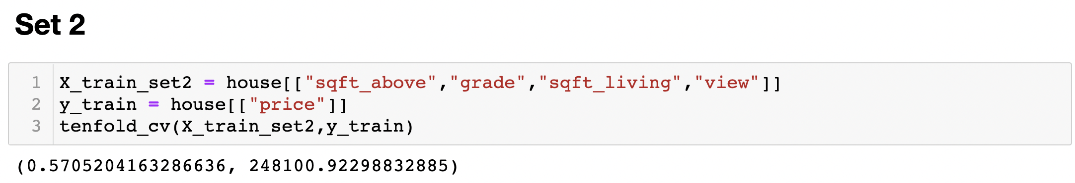
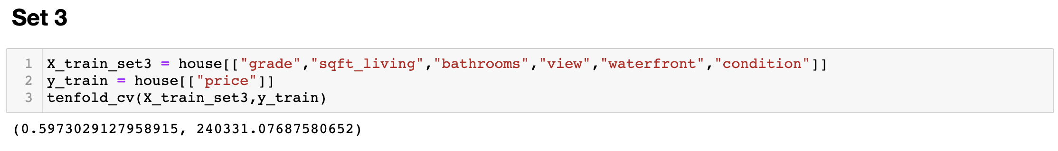
We have these predictors as they have high correlation with price from the heat map
We have added another predictor view which has next highest correlation value
We have added other predictors which have some mild correlation with price and we can see clearly RMSE value has decreased and R square increased

Slide 19
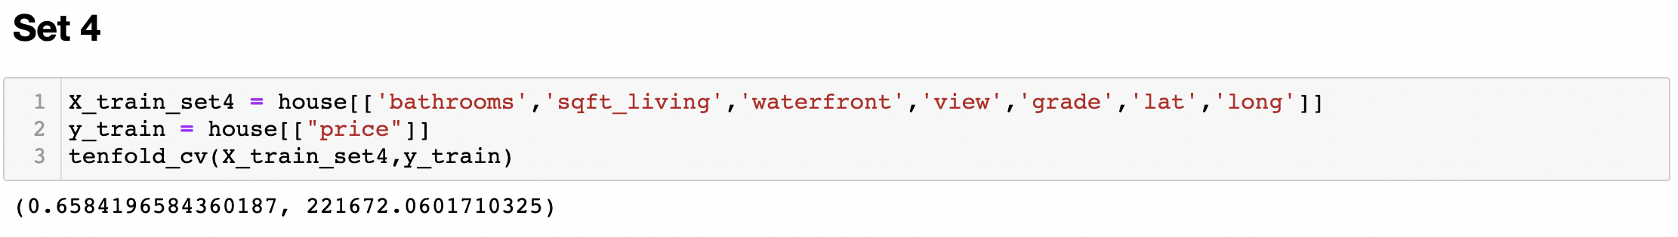
Moreover, various sets of predictors were considered, but the above set had the highest R square and lowest RMSE score

Slide 20
Feature Engineering

Slide 21
Value transformation
First, we have taken a log, square and square root transformation for all the numerical features.
Then we check the correlation between each features and the price of the house.
We found out that there is some improvement in the correlation from square transformations, although initially we have considered this but later on we found out that the data has been rightly skewed. So we ignored transformations.

Slide 22
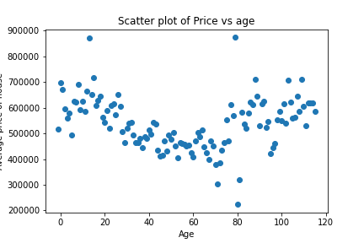
Feature Generation
For feature generation we have used date data such as the year of house sold, renovation data, house built date, to estimate the age of the house.
Though this we were able to understand effect of age of house on the price of the house is selling.
Initially as the house is relatively new, the prices are high. But as an when years pass by the price of the house starts decreasing. However, as the house cross 50 years of age the price starts to go up due to the history and antique nature of the house.

Slide 23
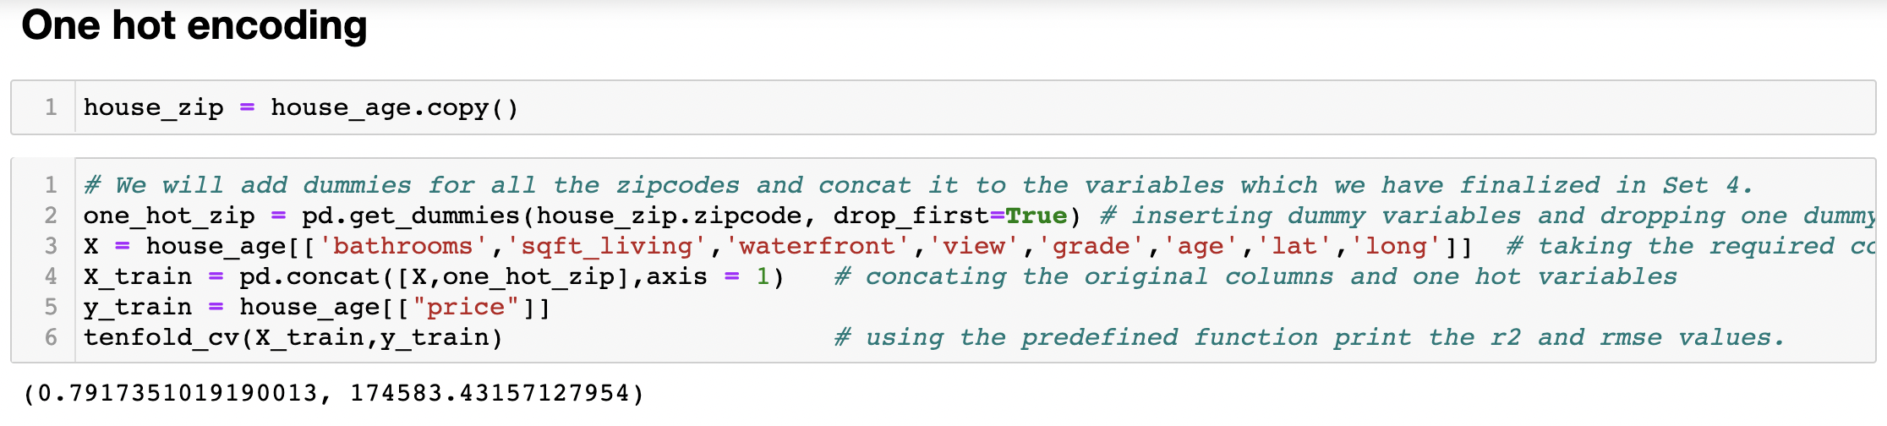
One-hot encoding
One-hot encoding is used in machine learning to quantify categorical data. Here in our dataset, the zipcode dataset is the categorical variable.
It might be possible that the prices of the house might depend on the where it resides. Thus to prove this we have used one-hot encoding on zipcode feature where it will 70 dummy variable for each unique zip code in the data.
These dummy variables were later used together to the earlier selected predictors in the linear regression model and we observed that the R square and RMSE score were significantly improved.

Slide 24
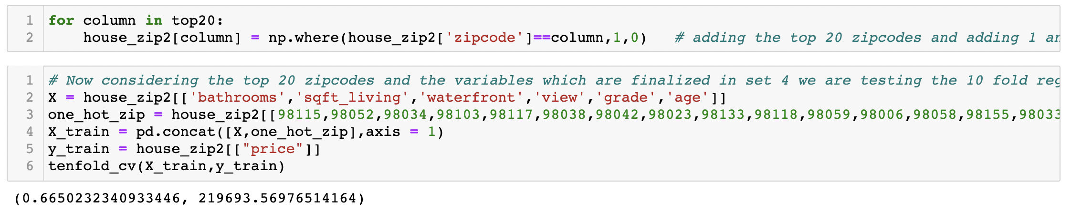
One-hot encoding
Moreover, to rectify the problem of multiple feature in the model. We have selected the top 20 zipcode out the 70 on the basis of the count.
However, it did not work here because in our case samples are taken in more number for every zip code. The zipcode data is distributed well and it is not concentrated to one category. So this technique will not work here as we can see r2 decreased and rmse increased

Slide 25
Model fitting
Backward Elimination & Forward Selection

Slide 26
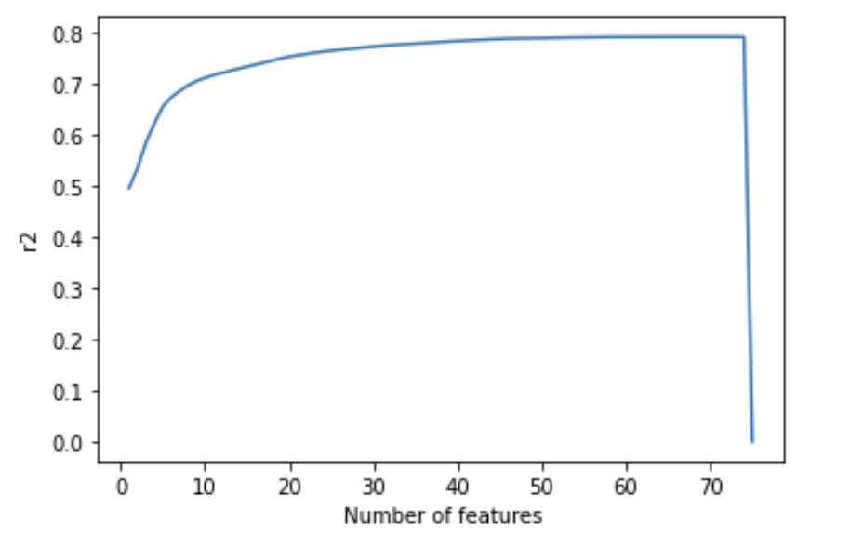
Backward elimination
Backward stepwise selection (or backward elimination) is a variable selection method which: Begins with a model that contains all variables under consideration (called the Full Model), then starts removing the least significant variables one after the other Until a pre-specified stopping rule is reached or until no variable is left in the model
In our model we have used the prior selected primary features plus one-hot encoded zipcodes features and passed it
So we had 76 features and we wanted to minimize the the number of features and maximized the R square for the model.
and through backward elimination we were able to narrow to near 40 features, where increasing the number of features were not increasing the R square significantly.

Slide 27
Forward Selection
In forward selection, the process will take single features at a time and calculate R square and will the top n features which has highest R squares.
In forward selection too, we narrowed it down to 40 features and tried to fit it on the linear regression model.

Slide 28
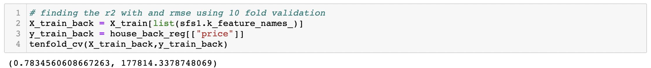
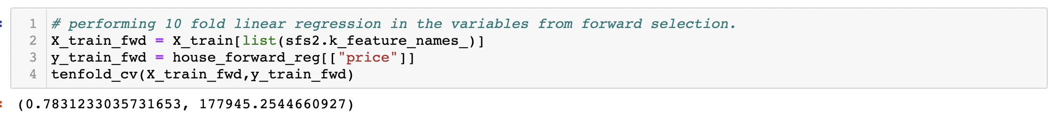
Backward Elimination
Forward Selection

Slide 29
Model Fitting
Decision Tree

Slide 30
Decision tree
For Decision tree we have only considered two sets of features
Primary features from linear regressions and whole one-hot encoded zipcode features
Features set we got from the forward selection.
To optimize and find out the best hyperparameter (to be used in decision tree model) we have run a GridSearchCV function for both the datasets.
Then we used those hyperparameter metrics to run the decision tree model.
The result:
The model was giving higher R score and lowest RMSE value for the first set of features. Thus we decided to forward with the feature set no. 1.

Slide 31
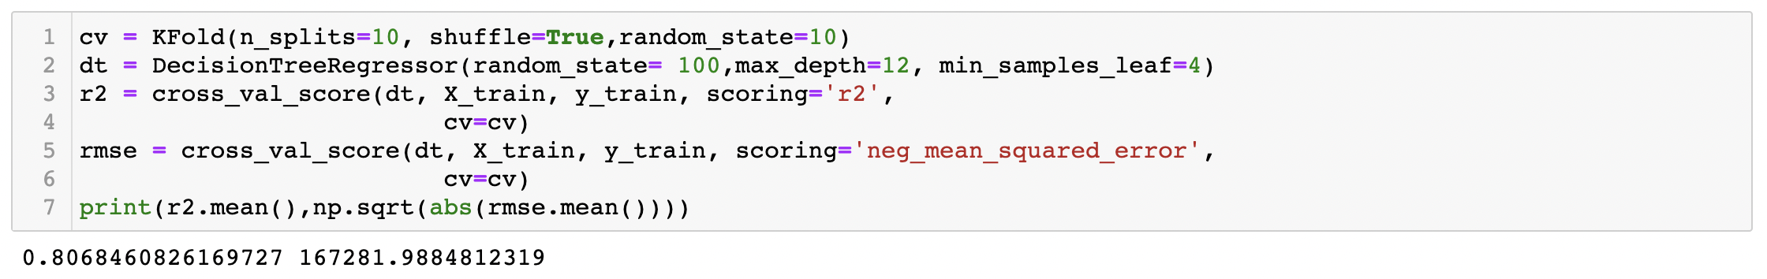
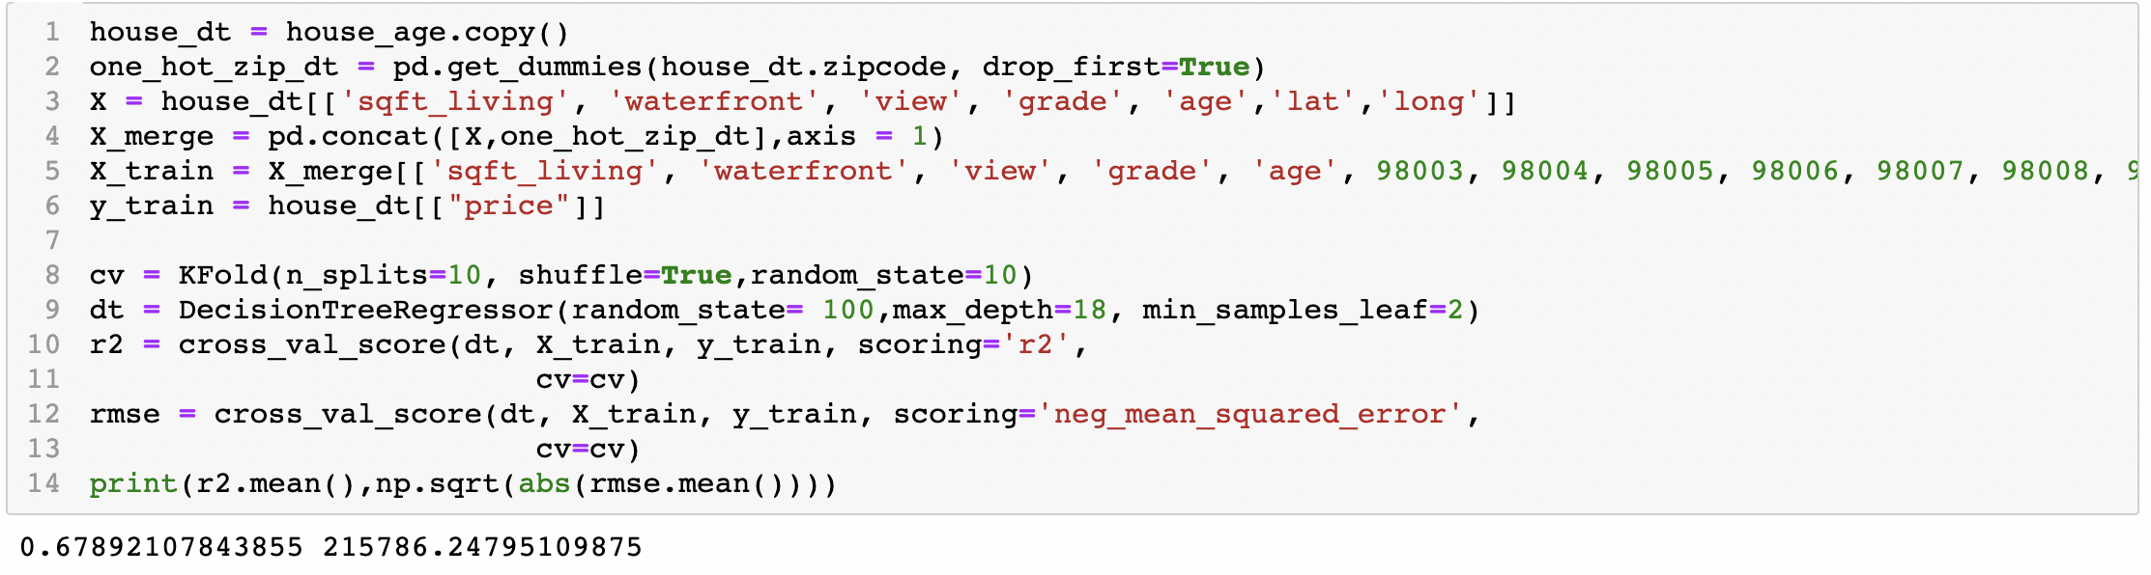
Feature set no. 1
Feature set no. 2

Slide 32
Model testing

Slide 33
Model testing
We have imported the test data and we have added the age and one-hot encoded the zipcode feature to make the test data compactible with the training data set.
Then we fitted the linear regression model on the train data and then predicted the values for test data.
We calculated the R square and RMSE for the above model.
For linear regression model we got the R square of 0.81 and RMSE score of 157944.13
Similarly, we ran the same sets of features on decision tree
For Decision Tree we got the R squre of 0.78 and RMSE score of 169480.66
In Conclusion, Multiple-linear Regression model performed better than the decision tree model.

Slide 34
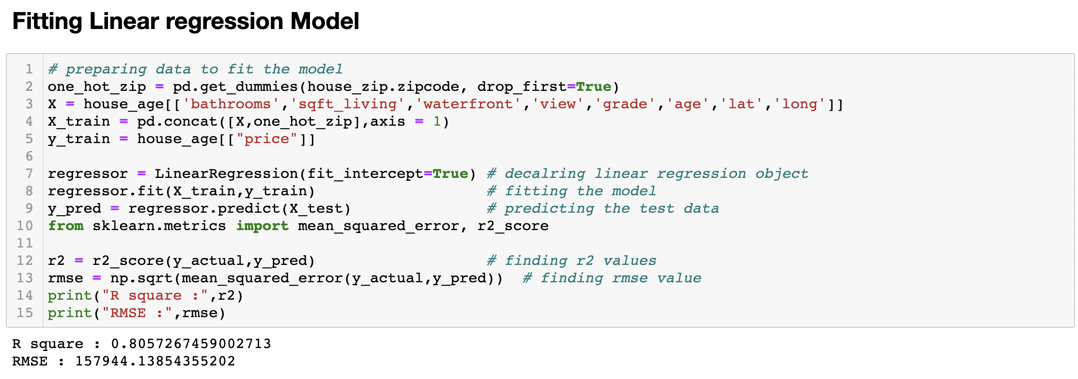
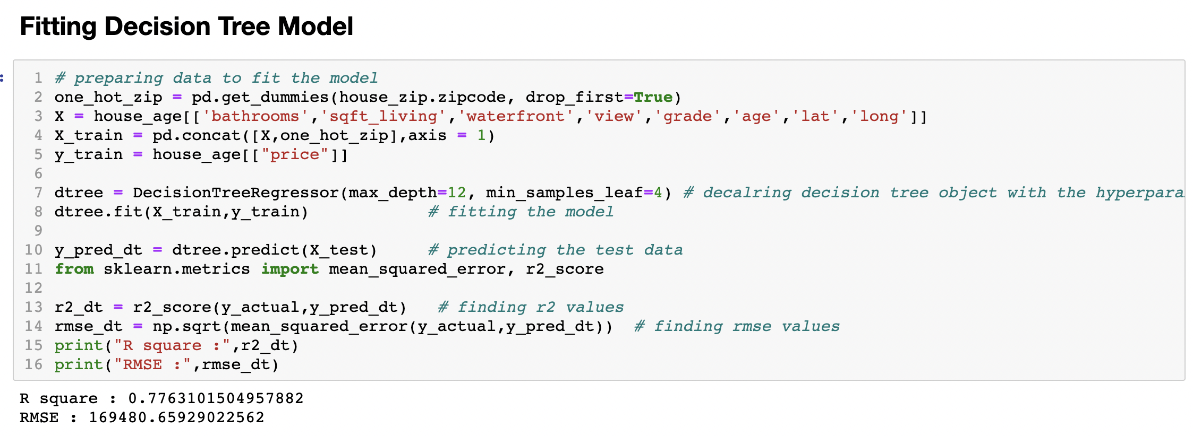

Slide 35
Thank you.

